Slide 1
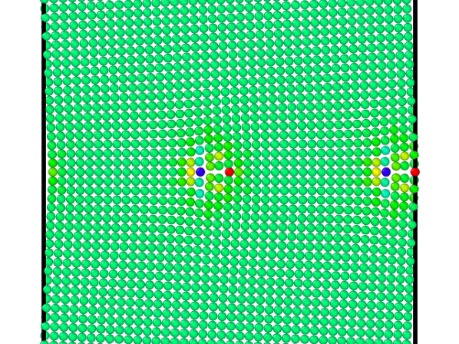
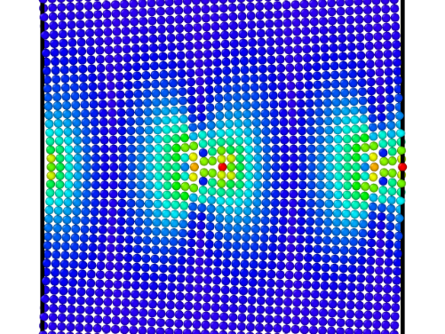
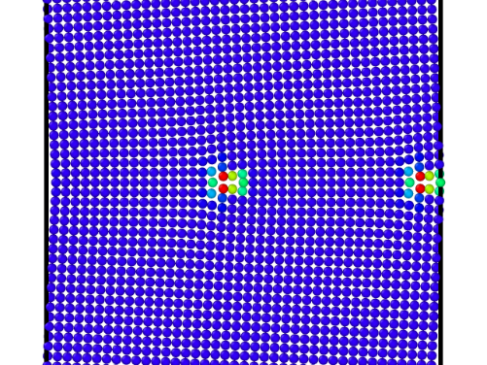
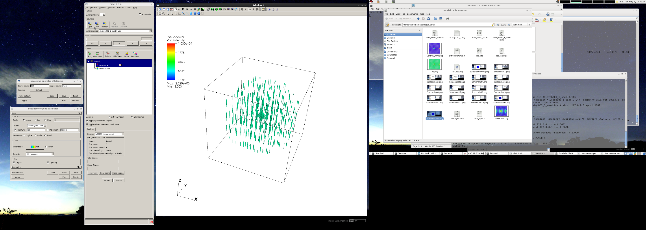
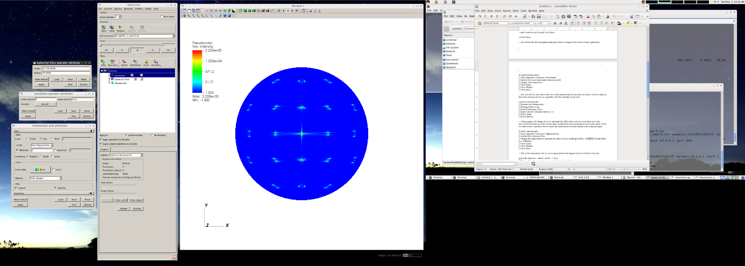
Tutorial- Virtual Diffraction
Potential Energy Von Mises Stress Centrosymmetry
Installation
Commands / Syntax
Example Problem
Input Script
Helper Script
Visualization
POC: Shawn Coleman
shawn.p.coleman8.ctr@mail.mil
(410) 306-0697

Slide 2
Installation: A) Copy these files into the lammps /src directory *There are special computes for MIC enabled architectures* B) Compile lammps with OpenMP enabled Example Makefiles for Spirit and Excalibur located in tutorial documents
Computes*
compute_saed.cpp
compute_saed.h
compute_saed_consts.h
compute_xrd.cpp
compute_xrd.h
compute_xrd_consts.h
Fixes
fix_ave_histo_weights.cpp
fix_ave_histo_weights.h
fix_saed_vtk.cpp
fix_saed_vtk.h

Slide 3
Compute XRD
compute ID group-ID xrd lambda type1 type2 ... typeN keyword value ...
ID / group-ID are documented in compute command
xrd Style name of this compute command
lambda Wavelength of incident radiation (length units)
type1 type2 ... typeN Chemical symbol of each atom type
Keywords
zero or more keyword/value pairs may be
appended keyword = 2Theta , c , LP ,
manual , or , echo
2Theta value Min2Theta Max2Theta (Minimum and maximum 2 theta range to explore in either degrees or radians)
c values c₁ c₂ c₃ (Parameters to adjust the spacing of the reciprocal lattice nodes in the h, k, and l directions respectively)
LP value 1 or 0 (Switch to apply Lorentz-polarization factor)
manual flag to use manual spacing of reciprocal lattice points based on the values of the c parameters
echo flag to provide extra output for debugging purposes

Slide 4
Compute XRD
Examples:
compute 1 all xrd 1.541838 B O 2Theta 0.087 0.87 c 1 1 1 LP 1 echo
compute 2 all xrd 1.541838 C O 2Theta 10.0 100.0 c 0.05 0.05 0.05 LP 1 manual
2Theta value Min2Theta Max2Theta (Minimum and maximum 2 theta range to explore in either degrees or radians)
c values c₁ c₂ c₃ (Parameters to adjust the spacing of the reciprocal lattice nodes in the h, k, and l directions respectively)
LP value 1 or 0 (Switch to apply Lorentz-polarization factor)
manual flag to use manual spacing of reciprocal lattice points based on the values of the c parameters
echo flag to provide extra output for debugging purposes

Slide 5
Compute XRD
Examples:
compute 1 all xrd 1.541838 B O 2Theta 0.087 0.87 c 1 1 1 LP 1 echo
compute 2 all xrd 1.541838 C O 2Theta 10.0 100.0 c 0.05 0.05 0.05 LP 1 manual
2Theta values can be inputted as radians or degrees. The output value will match the style of the input.
2Theta value Min2Theta Max2Theta (Minimum and maximum 2 theta range to explore in either degrees or radians)
c values c₁ c₂ c₃ (Parameters to adjust the spacing of the reciprocal lattice nodes in the h, k, and l directions respectively)
LP value 1 or 0 (Switch to apply Lorentz-polarization factor)
manual flag to use manual spacing of reciprocal lattice points based on the values of the c parameters
echo flag to provide extra output for debugging purposes

Slide 6
Compute XRD
Examples:
compute 1 all xrd 1.541838 B O 2Theta 0.087 0.87 c 1 1 1 LP 1 echo
compute 2 all xrd 1.541838 C O 2Theta 10.0 100.0 c 0.05 0.05 0.05 LP 1 manual
2Theta values can be inputted as radians or degrees. The output value will match the style of the input.
2Theta value Min2Theta Max2Theta (Minimum and maximum 2 theta range to explore in either degrees or radians)
c values c₁ c₂ c₃ (Parameters to adjust the spacing of the reciprocal lattice nodes in the h, k, and l directions respectively)
LP value 1 or 0 (Switch to apply Lorentz-polarization factor)
manual flag to use manual spacing of reciprocal lattice points based on the values of the c parameters
echo flag to provide extra output for debugging purposes
LP 1 will turn on Lorentz-polarization factor and apply a scaling to the diffraction intensity.

Slide 7
Compute SAED
compute ID group-ID saed lambda type1 type2 ... typeN keyword value ...
ID / group-ID are documented in compute command
saed Style name of this compute command
lambda Wavelength of incident radiation (length units)
type1 type2 ... typeN Chemical symbol of each atom type
Keywords
zero or more keyword/value pairs may be
appended keyword = Kmax , Zone ,
dR_Ewald , c , manual , echo
Kmax value Maximum distance explored from reciprocal space origin (inverse length units)
Zone values z₁ z₂ z₃ (Zone axis of incident radiation)
If z₁=z₂=z₃=0 all reciprocal space will be meshed up to Kmax
dR_Ewald value Thickness of Ewald sphere slice intercepting reciprocal space (inverse length units)
c values c1 c2 c3 (Parameters to adjust the spacing of the reciprocal lattice nodes in the h, k, and l directions respectively)
manual flag to use manual spacing of reciprocal lattice points based on the values of the c parameters
echo flag to provide extra output for debugging purposes

Slide 8
Compute SAED
Examples:
compute 1 all saed 0.0251 C H N O Kmax 1.70 Zone 0 0 1 dR_Ewald 0.01 c 0.5 0.5 0.5
compute 2 all saed 0.0251 Al O Kmax 1.70 Zone 0 0 0 c 0.05 0.05 0.05 manual echo
Kmax value Maximum distance explored from reciprocal space origin (inverse length units)
Zone values z₁ z₂ z₃ (Zone axis of incident radiation)
If z₁=z₂=z₃=0 all reciprocal space will be meshed up to Kmax
dR_Ewald value Thickness of Ewald sphere slice intercepting reciprocal space (inverse length units)
c values c1 c2 c3 (Parameters to adjust the spacing of the reciprocal lattice nodes in the h, k, and l directions respectively)
manual flag to use manual spacing of reciprocal lattice points based on the values of the c parameters
echo flag to provide extra output for debugging purposes

Slide 9
Compute SAED
Examples:
compute 1 all saed 0.0251 C H N O Kmax 1.70 Zone 0 0 1 dR_Ewald 0.01 c 0.5 0.5 0.5
compute 2 all saed 0.0251 Al O Kmax 1.70 Zone 0 0 0 c 0.05 0.05 0.05 manual echo
Kmax value Maximum distance explored from reciprocal space origin (inverse length units)
Zone values z₁ z₂ z₃ (Zone axis of incident radiation)
If z₁=z₂=z₃=0 all reciprocal space will be meshed up to Kmax
dR_Ewald value Thickness of Ewald sphere slice intercepting reciprocal space (inverse length units)
c values c1 c2 c3 (Parameters to adjust the spacing of the reciprocal lattice nodes in the h, k, and l directions respectively)
manual flag to use manual spacing of reciprocal lattice points based on the values of the c parameters
echo flag to provide extra output for debugging purposes
Focusing the calculation on a particular slice of reciprocal space will reduce the computational costs.

Slide 10
Compute SAED
Examples:
compute 1 all saed 0.0251 C H N O Kmax 1.70 Zone 0 0 1 dR_Ewald 0.01 c 0.5 0.5 0.5
compute 2 all saed 0.0251 Al O Kmax 1.70 Zone 0 0 0 c 0.05 0.05 0.05 manual echo
Kmax value Maximum distance explored from reciprocal space origin (inverse length units)
Zone values z₁ z₂ z₃ (Zone axis of incident radiation)
If z₁=z₂=z₃=0 all reciprocal space will be meshed up to Kmax
dR_Ewald value Thickness of Ewald sphere slice intercepting reciprocal space (inverse length units)
c values c1 c2 c3 (Parameters to adjust the spacing of the reciprocal lattice nodes in the h, k, and l directions respectively)
manual flag to use manual spacing of reciprocal lattice points based on the values of the c parameters
echo flag to provide extra output for debugging purposes
Focusing the calculation on a particular slice of reciprocal space will reduce the computational costs.
When using the manual flag, the c values define the spacing used in reciprocal space. This allows precise control of the mesh.

Slide 11
Fix ave/histo/weights
fix ID group-ID ave/histo/weights Nevery Nrepeat Nfreq lo hi Nbin value1 value2 ... keyword args ..
ID / group-ID are documented in compute command
ave/histo/weights Style name of this fix command
Nevery Use input values every this many timesteps
Nrepeat # of times to use input values for calculating averages
Nfreq calculate averages every this many timesteps
lo,hi low/high bounds within which to histogram
Nbin # of histogram bins
Value1 parameter over which the histogram is created
Keywords
Weights value2 parameter (same size as Value1) to weight histogram
Note, this has the same functionality as fix ave/histo but has the special keyword weights to compute a weighted histogram.

Slide 12
Fix saed/vtk
fix ID group-ID saed/vtk Nevery Nrepeat Nfreq c_ID ... keyword args ...
ID / group-ID are documented in compute command
saed/vtk Style name of this fix command
Nevery Use input values every this many timesteps
Nrepeat # of times to use input values for calculating averages
Nfreq calculate averages every this many timesteps
c_ID saed compute ID
Keywords
zero or more keyword/value pairs may be appended keyword = file, ave, start , file, or overwrite
Note, this has the same functionality as fix ave/time but is specially modified for compute saed to output into the 3rd generation vtk image data format for use in parallelized visualization software (i.e., Paraview or Visit).

Slide 13
Memory usage:
These can be a very memory intensive computations. Here are some helpful hints I’ve found:
1) Run diffraction computations with MPI/OpenMP.
I typically output data/dump files from LAMMPS and run the diffraction computations separate from minimizations and dynamics (MPI based).
2) Be mindful of the number of reciprocal lattice nodes being generated.
Several parameters will help control the number of reciprocal lattice nodes. I typically start with a courser grid and fine tune as needed.
Using the “echo” flag will report the number of reciprocal lattice nodes and progress of the calculation to the std_out.
compute 2 all saed 0.0251 Al O Kmax 1.70 Zone 0 0 0 c 0.05 0.05 0.05 manual echo

Slide 14
Example Problem: Al Grain Boundary (dump file)
Input Files:
Al.stgb001_1.dump - dump file with type x y z (and more) specified
DiffFromDump.in - general input script to create both XRD and SAED data
Loop_Dump_Diffraction_(Excalibur/Spirit) - helper scripts that creates PBS script that will run
separate LAMMPS diffraction jobs for all *dump files in the directory
Al.stgb001_1.dump
ITEM: TIMESTEP
1234
ITEM: NUMBER OF ATOMS
6408
ITEM: BOX BOUNDS pp pp pp
-0.0163336 81.1175
-162.221 162.221
0.000734495 4.04927
ITEM: ATOMS id type x y z c_PEatom c_Centro c_Voronoi[1] c_Voronoi[2] c_Voronoi[3] c_StrAtom[1] c_StrAtom[2] c_StrAtom[3] c_StrAtom[4] c_StrAtom[5] c_StrAtom[6] v_VonMises
664 1 2.26004 -160.1 0.000752652 -3.34756 0.0102832 17.0578 14 35.4252 111487 569825 211080 -38970.5 -0.401599 -0.86682 1.14865e+06
667 1 0.273626 -160.062 2.02502 -3.32373 0.0473431 17.1706 14 35.5702 65578.9 741402 197822 -82040.7 -1.07232 -0.766046 1.47112e+06
627 1 4.25886 -160.131 2.02502 -3.35472 0.00657964 16.9697 14 35.3018 127323 455503 181849 -2696.99 -0.147733 -0.912994 929016
624 1 6.26988 -160.15 0.000752568 -3.3569 0.0044887 16.8861 14 35.1846 113773 346869 150968 15448 -0.0583065 -0.931529 717780
587 1 8.28655 -160.163 2.02502 -3.35845 0.00337383 16.8129 14 35.0825 91048.7 256032 115073 27140.1 -0.032342 -0.937643 533933
547 1 12.3266 -160.181 2.02502 -3.35959 0.00238687 16.6855 14 34.9043 26450.3 108202 42834.5 37701.9 -0.0312845 -0.946344 219860

Slide 15
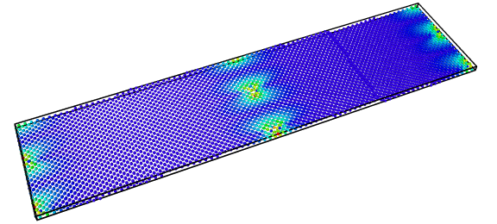
Example Problem: Al Grain Boundary (dump file)
Input Files:
Al.stgb001_1.dump - dump file with type x y z (and more) specified
DiffFromDump.in - general input script to create both XRD and SAED data
Loop_Dump_Diffraction_(Excalibur/Spirit) - helper scripts that creates PBS script that will run
separate LAMMPS diffraction jobs for all *dump files in the directory
Al.stgb001_1.dump
ITEM: TIMESTEP
1234
ITEM: NUMBER OF ATOMS
6408
ITEM: BOX BOUNDS pp pp pp
-0.0163336 81.1175
-162.221 162.221
0.000734495 4.04927
ITEM: ATOMS id type x y z c_PEatom c_Centro c_Voronoi[1] c_Voronoi[2] c_Voronoi[3] c_StrAtom[1] c_StrAtom[2] c_StrAtom[3] c_StrAtom[4] c_StrAtom[5] c_StrAtom[6] v_VonMises
664 1 2.26004 -160.1 0.000752652 -3.34756 0.0102832 17.0578 14 35.4252 111487 569825 211080 -38970.5 -0.401599 -0.86682 1.14865e+06
667 1 0.273626 -160.062 2.02502 -3.32373 0.0473431 17.1706 14 35.5702 65578.9 741402 197822 -82040.7 -1.07232 -0.766046 1.47112e+06
627 1 4.25886 -160.131 2.02502 -3.35472 0.00657964 16.9697 14 35.3018 127323 455503 181849 -2696.99 -0.147733 -0.912994 929016
624 1 6.26988 -160.15 0.000752568 -3.3569 0.0044887 16.8861 14 35.1846 113773 346869 150968 15448 -0.0583065 -0.931529 717780
587 1 8.28655 -160.163 2.02502 -3.35845 0.00337383 16.8129 14 35.0825 91048.7 256032 115073 27140.1 -0.032342 -0.937643 533933
547 1 12.3266 -160.181 2.02502 -3.35959 0.00238687 16.6855 14 34.9043 26450.3 108202 42834.5 37701.9 -0.0312845 -0.946344 219860

Slide 16
DiffFromDump.in
variable A string "PREFIX"
log $A.log
processors * * *
########################################################
###################### Variables #######################
########################################################
variable Restart string "DUMPFILE"
variable Species string "Al "
variable NTypes equal 1
variable eLambda equal 0.0251
variable Kmax equal 1.25
variable Zone0 equal 0
variable Zone1 equal 0
variable Zone2 equal 0
variable eRes0 equal 0.0075
variable eRes1 equal 0.0075
variable eRes2 equal 0.0075
variable dR_Ewald equal 0.0015
variable xLambda equal 1.541838
variable ThetaMin equal 30.0
variable ThetaMax equal 110.0
variable xRes0 equal 0.0075
variable xRes1 equal 0.0075
variable xRes2 equal 0.0075
variable LP equal 1
variable Nbins equal 3000
########################################################
lattice none 1.0
region chamber block 0 1 0 1 0 1
create_box ${NTypes} chamber
read_dump ${Restart} XXXXX x y z box yes add yes
mass * 26.9820
atom_modify sort 0 0.0
comm_style tiled
balance 0.9 rcb
pair_style none
########################################################
####################### Computes #######################
########################################################
compute SAED all saed ${eLambda} ${Species} Kmax ${Kmax} &
Zone ${Zone0} ${Zone1} ${Zone2} c ${eRes0} ${eRes1} ${eRes2} &
dR_Ewald ${dR_Ewald} echo manual
compute XRD all xrd ${xLambda} ${Species} 2Theta ${ThetaMin} &
${ThetaMax} c ${xRes0} ${xRes1} ${xRes2} LP ${LP} echo manual
fix 1 all saed/vtk 1 1 1 c_SAED file $A_saed
fix 2 all ave/histo/weights 1 1 1 ${ThetaMin} ${ThetaMax} &
${Nbins} c_XRD[1] weights c_XRD[2] mode vector file $A.xrd
run 0
unfix 1
unfix 2
uncompute SAED
uncompute XRD

Slide 17
DiffFromDump.in
variable A string "PREFIX"
log $A.log
processors * * *
########################################################
###################### Variables #######################
########################################################
variable Restart string "DUMPFILE"
variable Species string "Al "
variable NTypes equal 1
variable eLambda equal 0.0251
variable Kmax equal 1.25
variable Zone0 equal 0
variable Zone1 equal 0
variable Zone2 equal 0
variable eRes0 equal 0.0075
variable eRes1 equal 0.0075
variable eRes2 equal 0.0075
variable dR_Ewald equal 0.0015
variable xLambda equal 1.541838
variable ThetaMin equal 30.0
variable ThetaMax equal 110.0
variable xRes0 equal 0.0075
variable xRes1 equal 0.0075
variable xRes2 equal 0.0075
variable LP equal 1
variable Nbins equal 3000
########################################################
lattice none 1.0
region chamber block 0 1 0 1 0 1
create_box ${NTypes} chamber
read_dump ${Restart} XXXXX x y z box yes add yes
mass * 26.9820
atom_modify sort 0 0.0
comm_style tiled
balance 0.9 rcb
pair_style none
########################################################
####################### Computes #######################
########################################################
compute SAED all saed ${eLambda} ${Species} Kmax ${Kmax} &
Zone ${Zone0} ${Zone1} ${Zone2} c ${eRes0} ${eRes1} ${eRes2} &
dR_Ewald ${dR_Ewald} echo manual
compute XRD all xrd ${xLambda} ${Species} 2Theta ${ThetaMin} &
${ThetaMax} c ${xRes0} ${xRes1} ${xRes2} LP ${LP} echo manual
fix 1 all saed/vtk 1 1 1 c_SAED file $A_saed
fix 2 all ave/histo/weights 1 1 1 ${ThetaMin} ${ThetaMax} &
${Nbins} c_XRD[1] weights c_XRD[2] mode vector file $A.xrd
run 0
unfix 1
unfix 2
uncompute SAED
uncompute XRD
Species name for each atom type, up to NTypes
Keeping all diffraction compute options up front as variables.

Slide 18
DiffFromDump.in
variable A string "PREFIX"
log $A.log
processors * * *
########################################################
###################### Variables #######################
########################################################
variable Restart string "DUMPFILE"
variable Species string "Al "
variable NTypes equal 1
variable eLambda equal 0.0251
variable Kmax equal 1.25
variable Zone0 equal 0
variable Zone1 equal 0
variable Zone2 equal 0
variable eRes0 equal 0.0075
variable eRes1 equal 0.0075
variable eRes2 equal 0.0075
variable dR_Ewald equal 0.0015
variable xLambda equal 1.541838
variable ThetaMin equal 30.0
variable ThetaMax equal 110.0
variable xRes0 equal 0.0075
variable xRes1 equal 0.0075
variable xRes2 equal 0.0075
variable LP equal 1
variable Nbins equal 3000
########################################################
lattice none 1.0
region chamber block 0 1 0 1 0 1
create_box ${NTypes} chamber
read_dump ${Restart} XXXXX x y z box yes add yes
mass * 26.9820
atom_modify sort 0 0.0
comm_style tiled
balance 0.9 rcb
pair_style none
########################################################
####################### Computes #######################
########################################################
compute SAED all saed ${eLambda} ${Species} Kmax ${Kmax} &
Zone ${Zone0} ${Zone1} ${Zone2} c ${eRes0} ${eRes1} ${eRes2} &
dR_Ewald ${dR_Ewald} echo manual
compute XRD all xrd ${xLambda} ${Species} 2Theta ${ThetaMin} &
${ThetaMax} c ${xRes0} ${xRes1} ${xRes2} LP ${LP} echo manual
fix 1 all saed/vtk 1 1 1 c_SAED file $A_saed
fix 2 all ave/histo/weights 1 1 1 ${ThetaMin} ${ThetaMax} &
${Nbins} c_XRD[1] weights c_XRD[2] mode vector file $A.xrd
run 0
unfix 1
unfix 2
uncompute SAED
uncompute XRD
No effect on the computation of diffraction patterns!
The helper script automatically fills in these values using each dump file in the directory. (or change these manually)

Slide 19
Create/Submit Jobs with Helper Script
*Modify the following defaults values in Loop_Dump_Diffraction_(Excalibur/Spirit)
ACCOUNT=YOUR_ACCOUNT_HERE
EMAIL=YOUR_EMAIL_HERE
LAMMPS=YOUR_PATH_TO_LAMMPS_HERE
excalibur:> ls
Al.stgb001_1.dump DiffFromDump.in Loop_Dump_Diffraction_Excalibur
excalibur:> Loop_Dump_Diffraction_Excalibur -q d -n 1 -t 30 -D DiffFromDump.in Example

Slide 20
Create/Submit Jobs with Helper Script
*Modify the following defaults values in Loop_Dump_Diffraction_(Excalibur/Spirit)
ACCOUNT=YOUR_ACCOUNT_HERE
EMAIL=YOUR_EMAIL_HERE
LAMMPS=YOUR_PATH_TO_LAMMPS_HERE
excalibur:> ls
Al.stgb001_1.dump DiffFromDump.in Loop_Dump_Diffraction_Excalibur
excalibur:> Loop_Dump_Diffraction_Excalibur -q d -n 1 -t 30 -D DiffFromDump.in Example
Dump file and DiffFromDump.in must be located in the current directory

Slide 21
Create/Submit Jobs with Helper Script
*Modify the following defaults values in Loop_Dump_Diffraction_(Excalibur/Spirit)
ACCOUNT=YOUR_ACCOUNT_HERE
EMAIL=YOUR_EMAIL_HERE
LAMMPS=YOUR_PATH_TO_LAMMPS_HERE
excalibur:> ls
Al.stgb001_1.dump DiffFromDump.in Loop_Dump_Diffraction_Excalibur
excalibur:> Loop_Dump_Diffraction_Excalibur -q d -n 1 -t 30 -D DiffFromDump.in Example
Last input value = Run name
# of nodes
Basename for diffraction calculation
queue
d=debug
s=standard
time = dd:hh:mm
15 min 30 seconds 32 processors on Excalibur

Slide 22
Outputs
(100Kb) Al.stgb001_1.xrd
2θ values in 2nd column
Intensity values in 3rd column
Plot these values
(246Mb) Al.stgb001_1_saed.0.vtk
This vtk format is for a regularly spaced data filling a
cubic volume, but our data has spherical limits.
Ghost data (value=-1) fills in the volume outside the
sphere to make this data structure cubic.
4 line header
# Histogrammed data for fix 2
# TimeStep Number-of-bins Total-counts Missing-counts Min-value Max-value
# Bin Coord Count Count/Total
1234 3000 4.08972e+10 0 30.0016 109.992
1 30.0133 9.63929e+06 0.000235696
2 30.04 6.17153e+06 0.000150904
3 30.0667 3.50073e+06 8.55983e-05
4 30.0933 1.47572e+06 3.60837e-05
5 30.12 1.24187e+07 0.000303656
…
10 line header
# vtk DataFile Version 3.0 c_SAED
Image data set
ASCII
DATASET STRUCTURED_POINTS
DIMENSIONS 335 335 335
ASPECT_RATIO 0.0075 0.0075 0.0075
ORIGIN -1.2525 -1.2525 -1.2525
POINT_DATA 37595375
SCALARS intensity float
LOOKUP_TABLE default
-1
-1
…

Slide 23
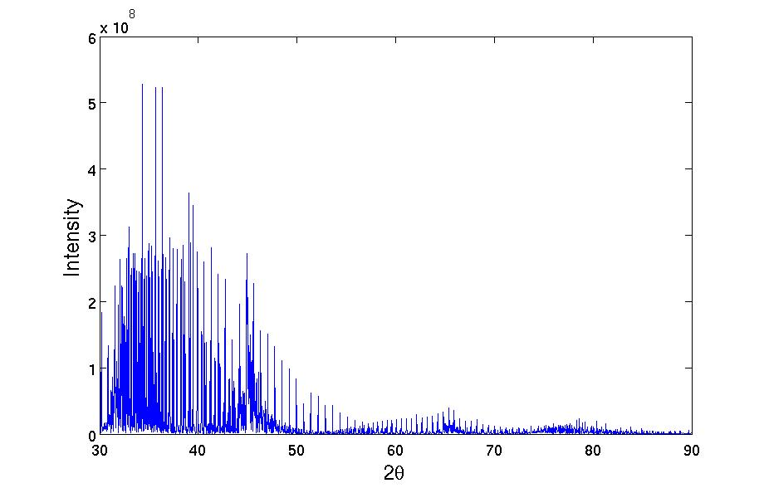
Outputs
Visualizations: xrd
Jagged diffraction patterns indicate a problem with the binning
XRD plots are sensitive to the spacing of the reciprocal lattice points, the bin size of the histogram, and relrods from the finite simulation volume.
The example showcases all these problems!
Hints:
2θ binning should be large enough to contain multiple reciprocal lattice points.
Larger simulations will reduce the effects
of relrods. Periodic boundaries are not
accounted for in the diffraction
calculations.
6408 atoms

Slide 24
Visualizations: vtk in VisIt

Slide 25
Visualizations: vtk in VisIt
f) Select intensity plot
Click Operators->Slicing>Spherical Slice
Double click Spherical Slice
Change the origin/radius to represent the center of your Ewald sphere
(i.e. 39.84063 0 0) and radius (i.e. 39.84063)
Click Apply
Click Dismiss
Click Draw
This is the saed pattern, but we are not guaranteed to be aligned correctly with the zone axis.
g) On the menu bar... select Controls -> View
Change View Normal to the zone axis of choice (i.e. -1 0 0)
Adjust Up Vector if desired (i.e. 0 1 0)
Turn of Perspective view
Click Apply
Click Dismiss
Note that for the primary x, y, and z zone axis you can use the drop down Align to axis. However, it is likely that there is a bunch of extra annotations on the image that don't look appealing.
h) On the menu bar... select Control-> Annotation
Here you can change what is visualized along side the data and how you display axis information. I typically turn most all the display information off.
i) Save the image
Click File-> Set save options
Click Save
a) Open the diffraction .vtk files in VisIt
b) Click add->pseudocolor->intensity
Green name means its ready to be drawn
c) Click Draw
You will see the full rectangular mesh grid which is not good. We need to remove ghost data
d) Select intensity plot;
Click Operators->Selection->Isovolume;
Double click isovolume (under intensity plot);
Change lower bound to 0
Click Apply
Click Dismiss
Click Draw
Now you will see only where there was valid intensity data (if you don't use Zone it will be a sphere). But most intensity are low so I typically color the intensity by log scale.
e) Select intensity plot
Double click Pseudocolor;
Change Scale to Log
Check Mimimum Limit
Input non-zero minimum limit (i.e. 1)
Click Apply
Click Dismiss
Clicking apply will change the scale automatically. But unless you have used Zone and a thin dR_Ewald you likely have lots of extra data visualized that does not intersect the Ewald sphere. Next we want to take a spherical slice to mimic the intersection of Ewald's sphere with reciprocal space.

Slide 26
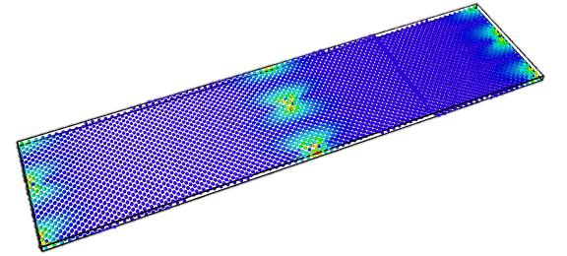
Visualizations: vtk in VisIt
Relrods are largest in the thinnest direction of the simulation!

